Slide 1

“Application For Grocery Delivery”
Task - 2

Slide 2
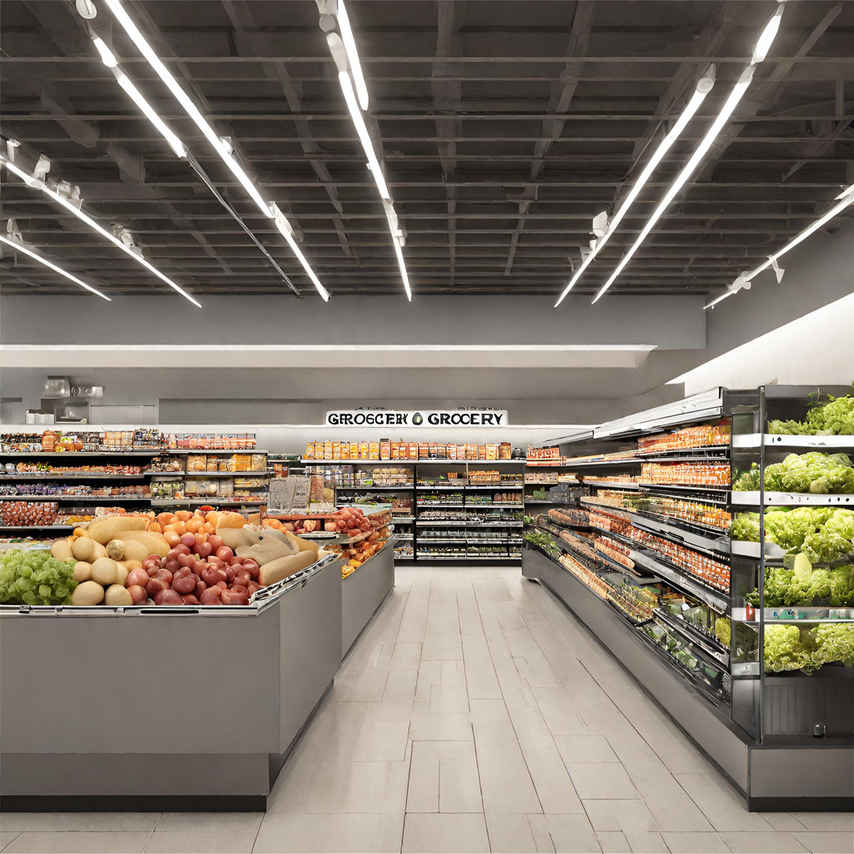
Our project introduces an innovative Grocery System, combining cutting-edge technology with industry best practices to enhance the grocery shopping experience. With a focus on operational efficiency, customer satisfaction, and inventory optimization, our system aims to modernize the grocery retail sector. By embracing the trends in online and offline shopping, we empower customers and store owners alike, creating a more sustainable and profitable grocery ecosystem.
Application For Grocery Delivery
▪
au910020104301 |  | CC2
au910020104036 |  | CC2
au910020104008 |  | CC2
LMS Username
Name
Batch
AKSHAYA G
RAJASURIYA M
ARUN S

Slide 3
Step-WiseDescription
1. Component Architecture:
- Utilize main components and HOCs for modularity.
- Break down components for code reusability.
2. Basic UI Setup:
- Create foundational UI with dummy data.
- Manage dynamic content using state and props.
3. API Integration
- Connect APIs, design efficient calls, and handle errors.
4. Secure Content Handling:
- Ensure secure data transmission.
- Implement authentication for sensitive content.
5. Testing and Deployment:
- Thoroughly test components and deploy securely.
- Monitor performance and resolve issues proactively.

Slide 4
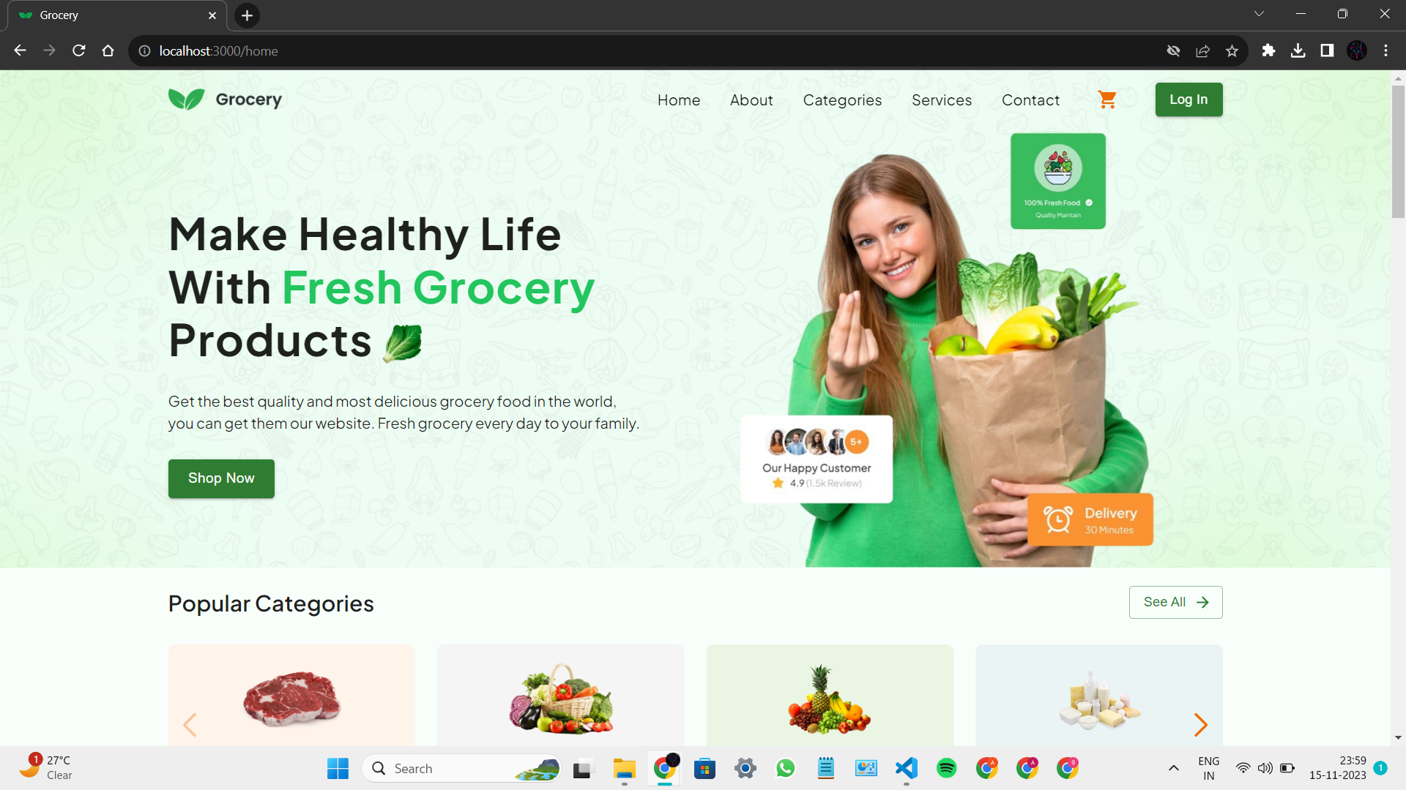
Front Page Design

Slide 5
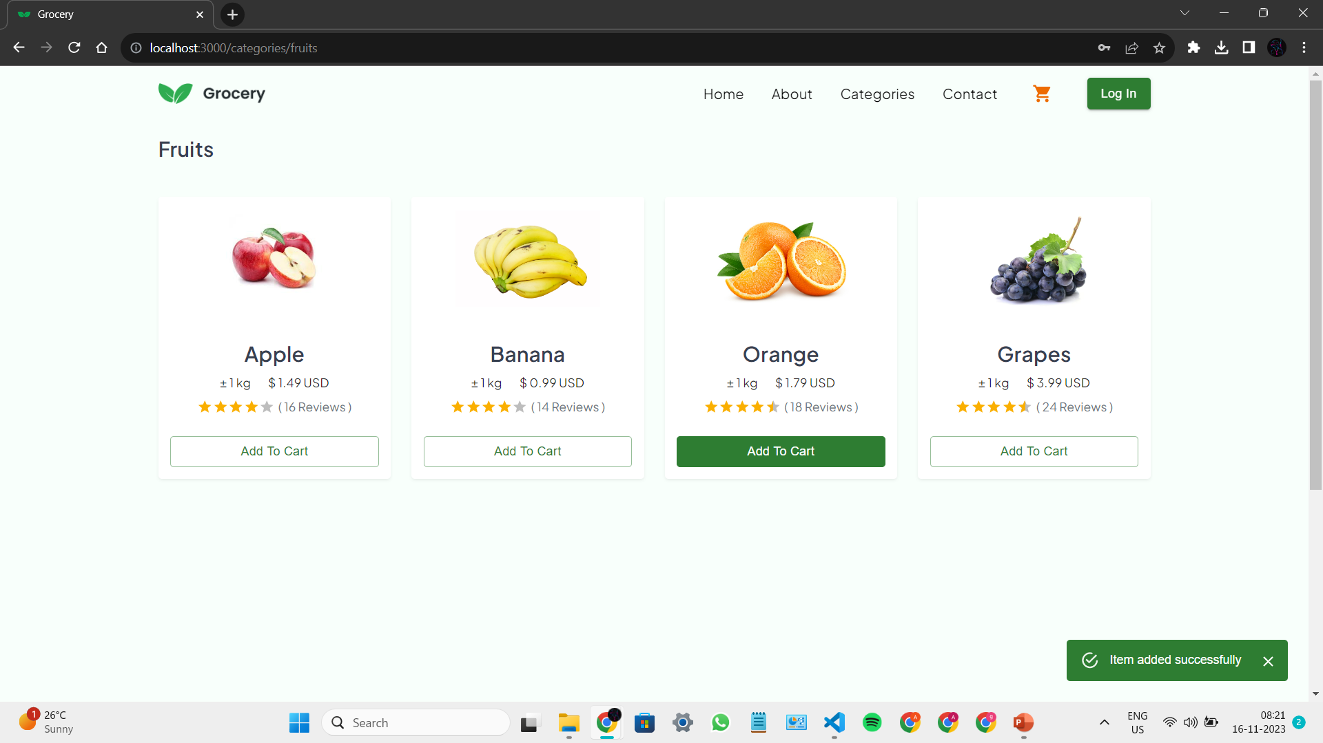
Ordering Groceries

Slide 6
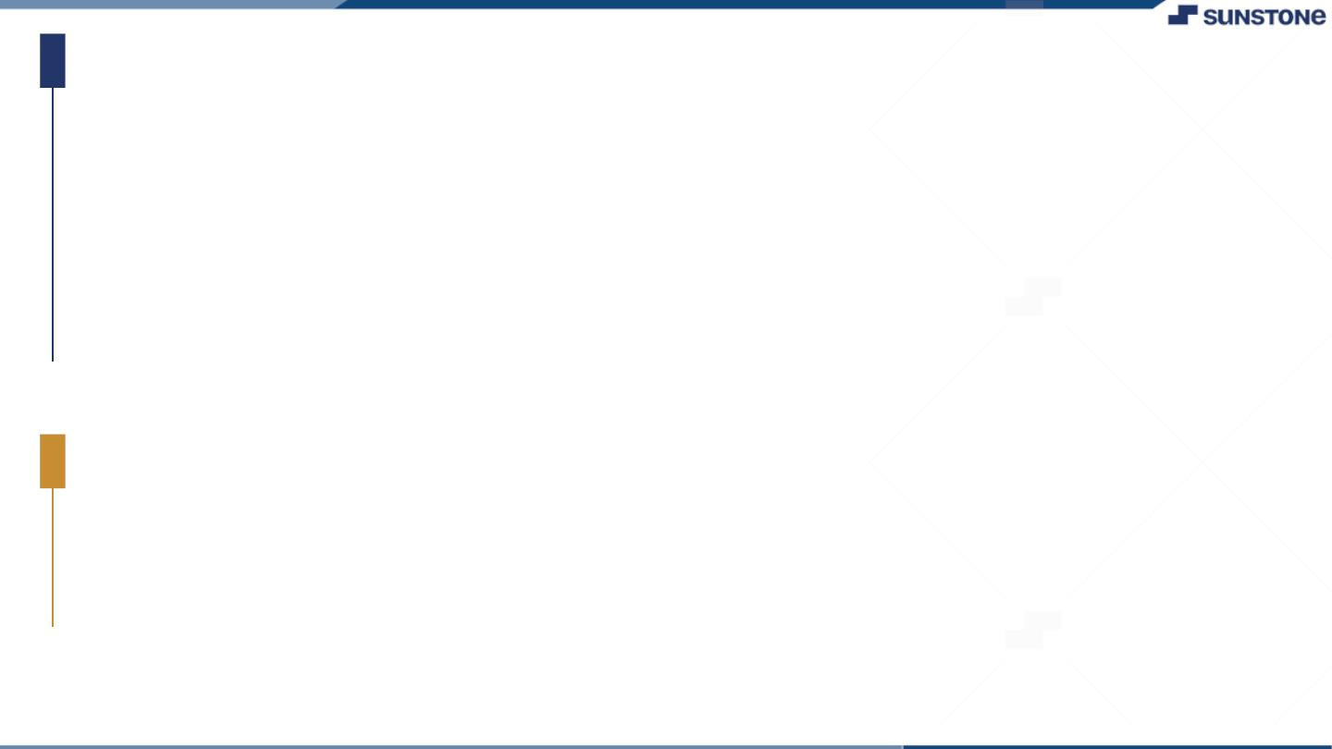
Task Summary
To Develop a grocery app in React with modular components and HOCs. Create a foundational UI, manage dynamic content, and seamlessly integrate APIs with robust error handling. Prioritize security measures like secure data transmission and authentication. Thoroughly test components, deploy securely, and monitor ongoing performance for a dynamic and secure grocery application.

Slide 7
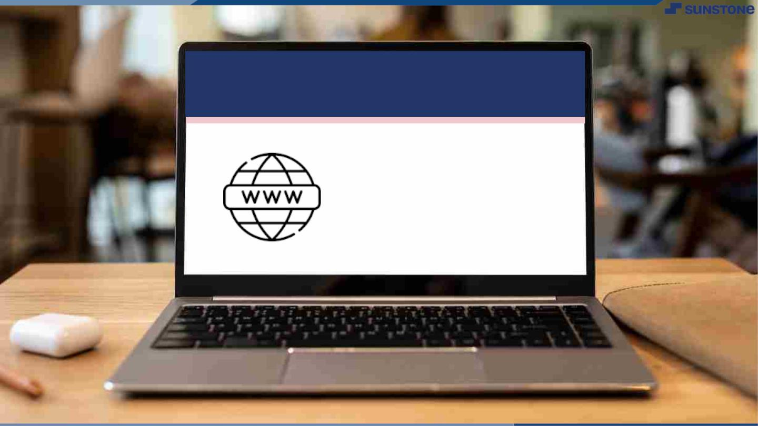
Submission Github
Github Link
https://github.com/Suryao3/nm_modules/tree/main/Module%202

Slide 8


